Slide 1
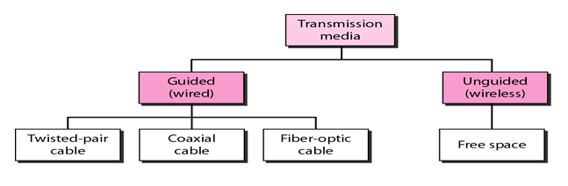
Transmission Media
The transmission medium can be defined as a pathway that can transmit information from a sender to a receiver
Transmission media are located below the physical layer and are controlled by the physical layer

Slide 2

Guided Media: It is defined as the physical medium through which the signals are transmitted.
Twisted pair:
Twisted pair is a physical media made up of a pair of cables twisted with each other. A twisted pair cable is cheap as compared to other transmission media.
Installation of the twisted pair cable is easy, and it is a lightweight cable.
The frequency range for twisted pair cable is from 0 to 3.5KHz.

Slide 3
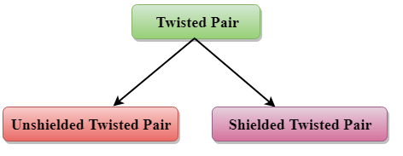
Types Of Twisted pair
Unshielded Twisted Pair:
An unshielded twisted pair is widely used in telecommunication
Following are the categories of the unshielded twisted pair cable:
Category 1: Category 1 is used for telephone lines that have low-speed data.
Category 2: It can support up to 4Mbps.
Category 3: It can support up to 16Mbps.
Category 4: It can support up to 20Mbps. Therefore, it can be used for long-distance communication.
Category 5: It can support up to 200Mbps.

Slide 4
Shielded Twisted Pair A shielded twisted pair is a cable that contains the mesh surrounding the wire that allows the higher transmission rate

Slide 5
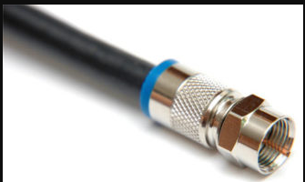
Coaxial Cable:
Coaxial cable (or coax) carries signals of higher frequency ranges than those in twisted pair cable. coax has a central core conductor of solid (usually copper) enclosed in an insulating sheath, which is, in turn, encased in an outer conductor of metal foil, braid, or a combination of the two.
The inner conductor of the coaxial cable is made up of copper, and the outer conductor is made up of copper mesh. The middle core is made up of non-conductive cover that separates the inner conductor from the outer conductor
The middle core is responsible for the data transferring whereas the copper mesh prevents from the EMI(Electromagnetic interference)

Slide 6
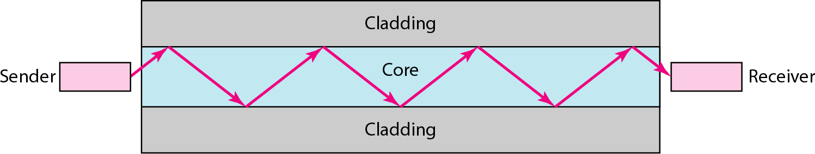
Fiber Optic Cable
Fiber optic cable is a cable that uses electrical signals for communication.
Fiber optic is a cable that holds the optical fibers coated in plastic that are used to send the data by pulses of light.
The plastic coating protects the optical fibers from heat, cold, electromagnetic interference from other types of wiring.
Fiber optics provide faster data transmission than copper wires.

Slide 7
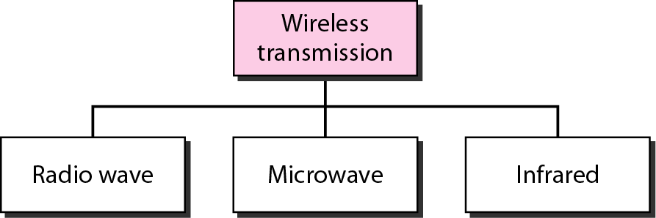
Unguided Media: An unguided transmission transmits the electromagnetic waves without using any physical medium. Therefore it is also known as wireless transmission.

Slide 8
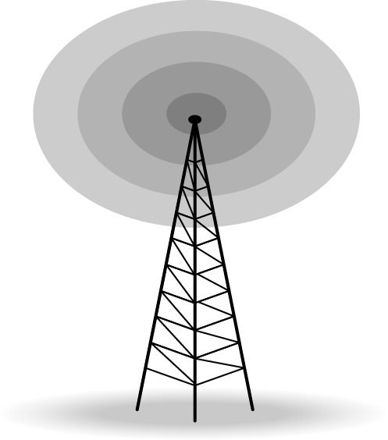
Radio Waves
Radio waves are the electromagnetic waves that are transmitted in all the directions of free space.
These waves have the longest wavelengths, from 1mm to 100km in the spectrum. The name itself has Radio. A Radio is one of the thousands of wireless technologies that use Radio waves for communication.
Other examples include RADAR, Satellite communications, Bluetooth headsets, TV Broadcasts, GPS Signals

Slide 9
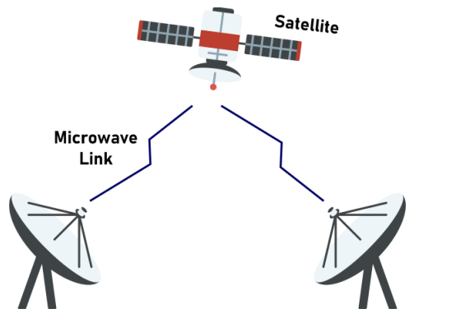
Microwaves
These waves are also a part of electromagnetic radiation. The micro indicates that these waves have short wavelengths from 1 meter to 1 millimeter.
These are high-frequency waves-> Frequency range: 300MHz to 300GHz. These waves fall between Radio waves and Infrared waves.
These waves are used for point-to-point communication as it only transmits data in one direction.

Slide 10
Infrared
Low frequency infrared waves are used for very short distance communication like TV remote, wireless speakers, automatic doors, hand held devices etc.
short range, it is considered to be one of the most secure transmission modes.

